Slide 1
Easylube Range of Software
Easylube® Total Patrol Management System (TPMS)
Easylube® on-site patrol software (Guardwatch®)
Easylube® remote monitoring software (Skymonitor®)
Even an inexperienced technician can follow the simple step by step guidelines to use our highly effective RFID technology based software

Slide 2
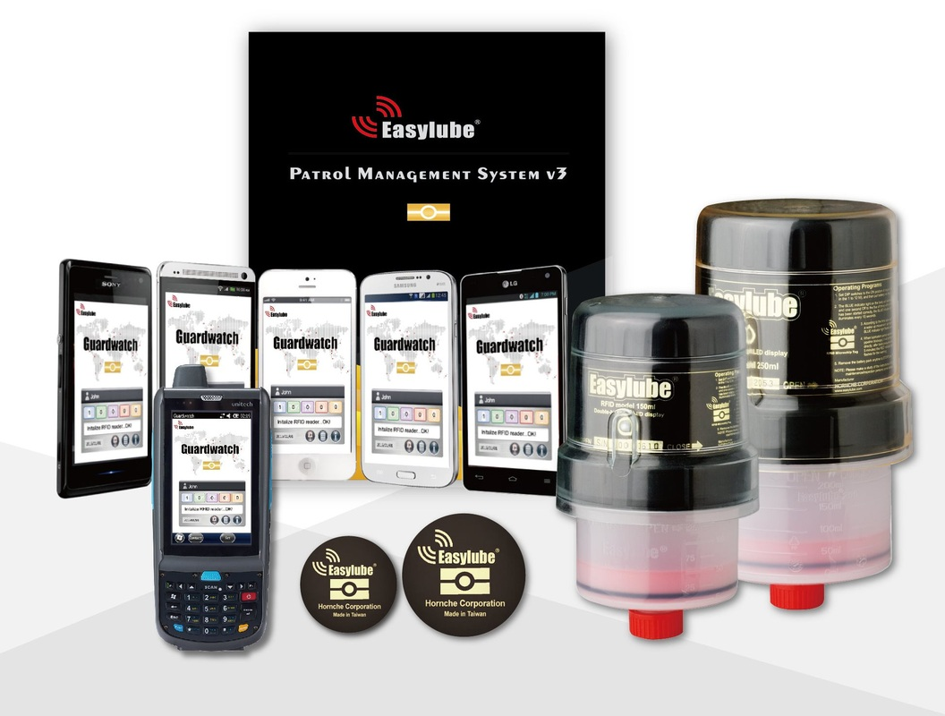
Easylube® Guardwatch software is equipped with a built-in RFID reader and MQL software.
Track specific Grease Feed Rate in each single lube-point on site.
Eliminate manual recording mistakes
Giving you up-to-date bearing lubrication information

Slide 3
Inspection, maintenance, monitoring & reporting

Slide 4
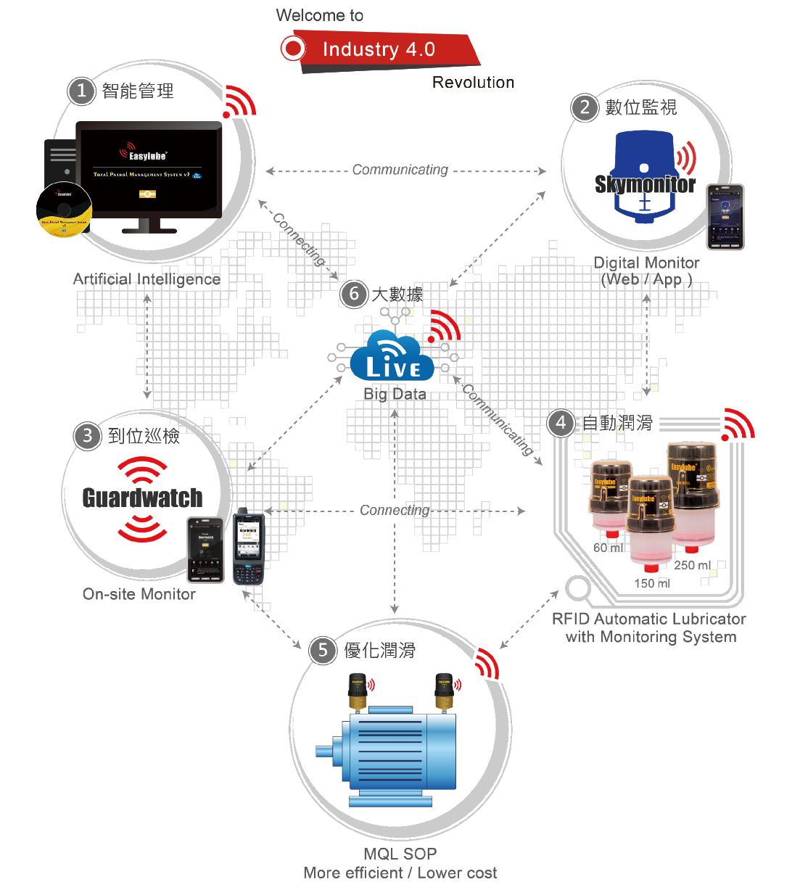

Slide 5
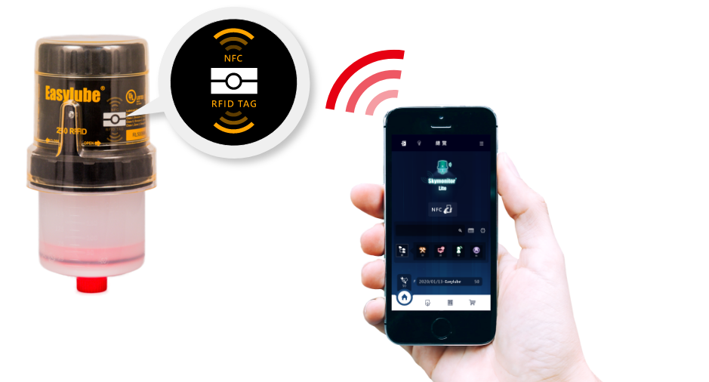
Optimizing Lubrication Practise
Easylube® smart automatic lubricator work in
any harsh environment
Delivering precise lubrication volume
At predetermined intervals
RFID wireless sensor chip manages "on-site inspections"
Ensuring100% reliable lubrication

Slide 6
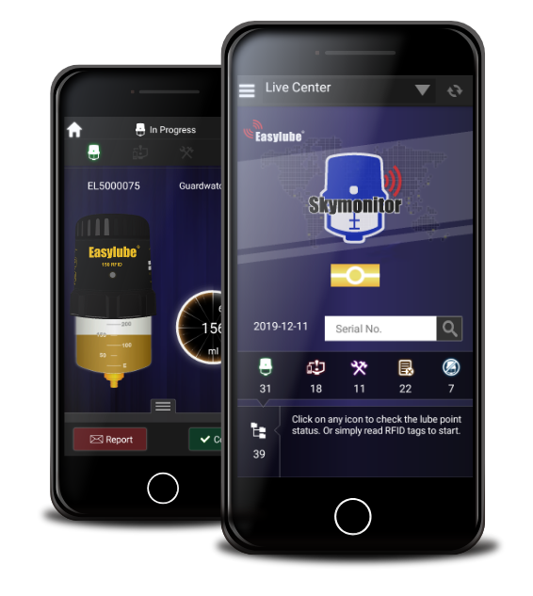
Solution Orientated
Establish lubrication standard operation procedures (SOP),
Simplify operation management,
Construct maintenance history reports,
Solve future maintenance labor issues
Reduce labour costs
Increase safety

Slide 7
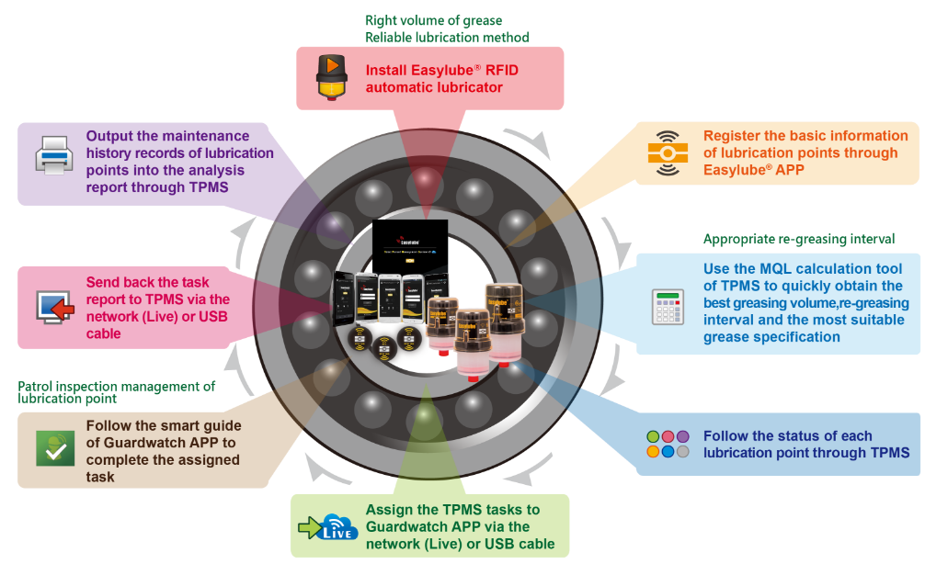
Easylube® Total Patrol Management System (TPMS)
Simplify lubrication and maintenance
Easy management of routine inspections
Remotely lubrication monitoring of each bearing.
Management can check if routine inspections were performed
Patrol Management System

Slide 8
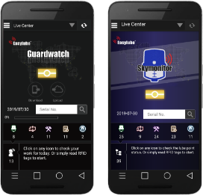
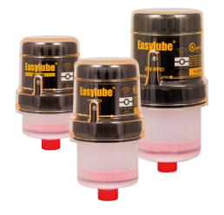
Lubrication Maintenance Software
Complete control of Lubrication Maintenance
Consolidate and Plan Maintenance tasks
Track and manage inspections

Slide 9
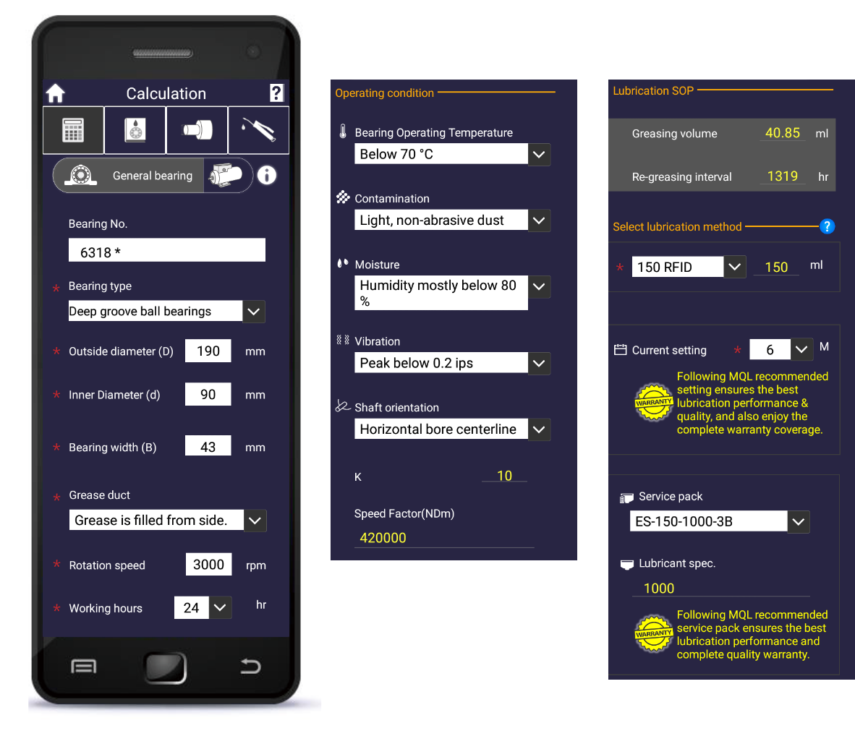
Standard Operating Procedure
Compute and determine:
1. greasing volume,
2. re-greasing interval
3. suitable grease specifications
4. bearing model,
5. operating speed, and
6. environmental conditions.
WITH THE:

Slide 10
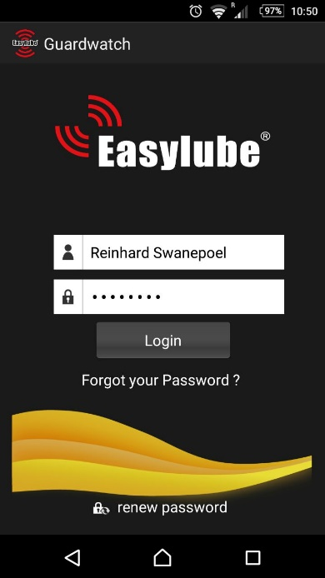
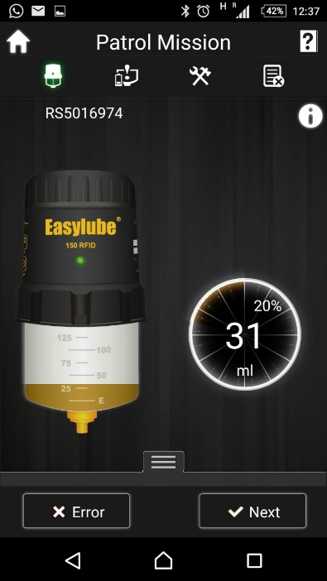
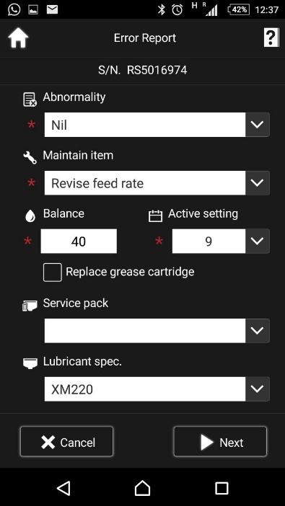
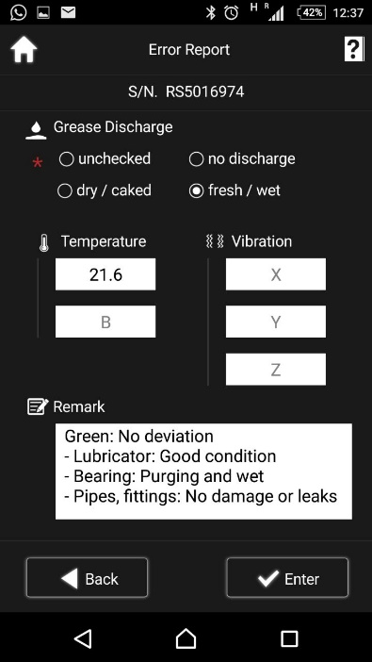
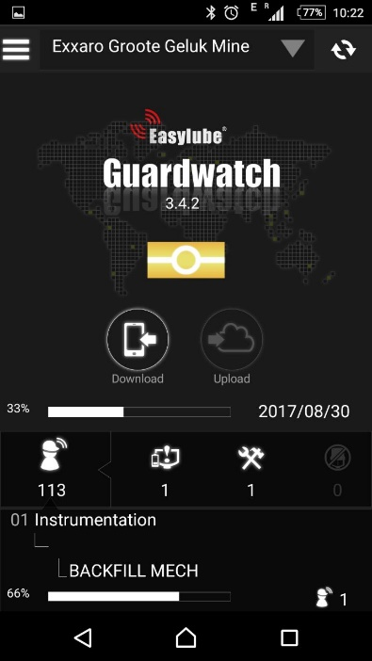
Field Inspections
Inspectors can use smartphones or PDA’s
Eliminate human error
Paperless reporting

Slide 11
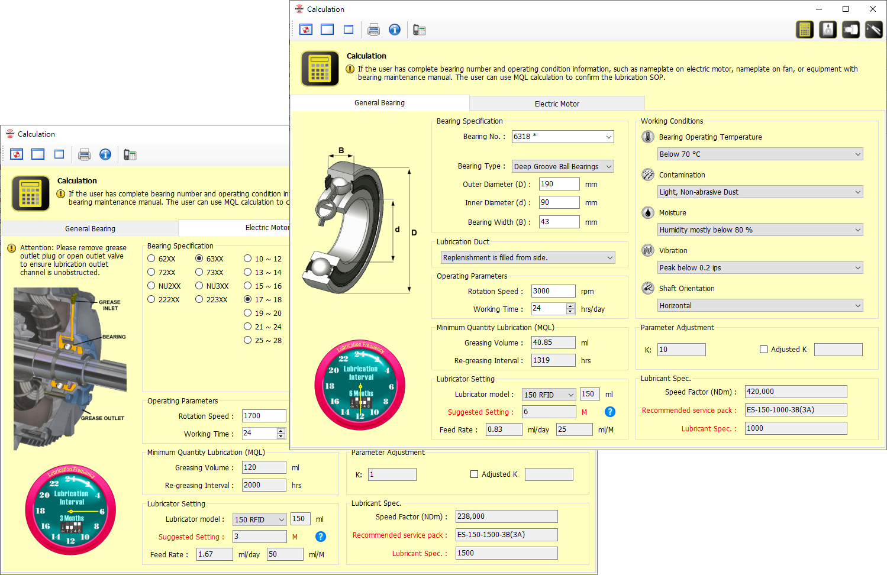
MQL Software
With more than 20 years practical experience in the bearing lubrication field
Easylube developed industrial leading software using tribology theories and AI

Slide 12
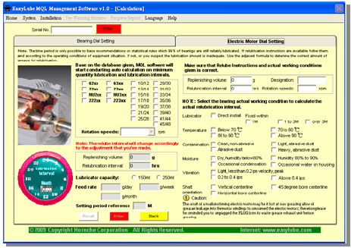
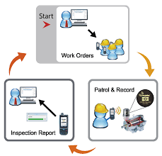
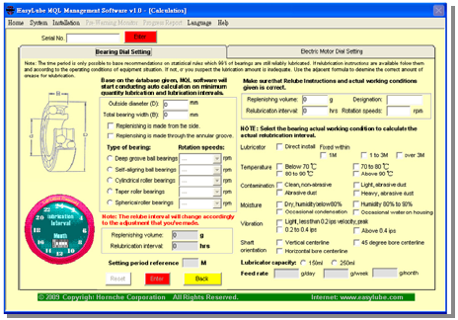
MQL Software

Slide 13
System Requirements

Slide 14
System Requirements

Slide 15
Excel Reports at your fingertips

Slide 16
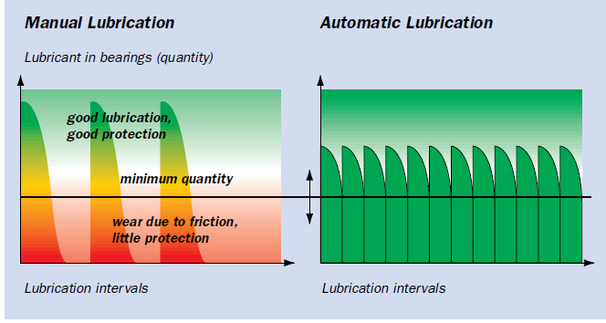
Advantages
Increase Profitability
Improved operating time / time of readiness
Less costs for repair / spare parts
Reduce lubricant consumption
Ultimate Reliability
Longer maintenance intervals
Hi-Tech lubrication & maintenance management

Slide 17
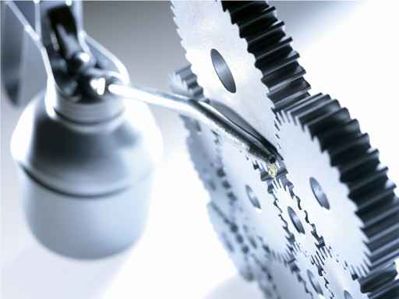
Advantages
Improving Working conditions and risk management.
Built-Up RFID technique with Pre-Warning LED lights when abnormality occurred in machine’s operation.
No more uncertainty in Grease interval and Grease volume on each single rolling bearing.
No lube points are missed during inspections.

Slide 18
Eliminate Manual Lubrication
Visual Inspection replaces manual lubrication
reducing man hours and down time.

Slide 19
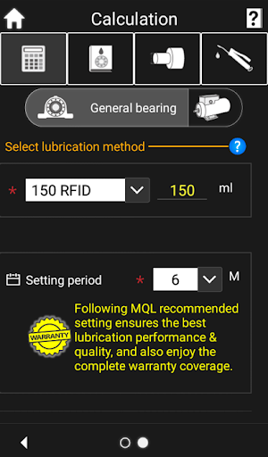
MQL Program Software
Simplify bearing lubrication program and permit drastic cuts in maintenance costs.
Scientific calculation to determine the correct Grease volume & Re-greasing interval.
Precise documentation and reporting on each point
User friendly software with practical application functions.

Slide 20
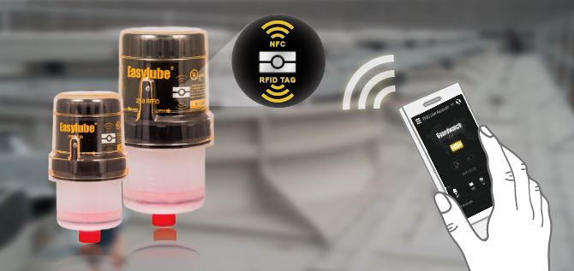
Fail-safe Accountability
Software
Service
System
RFID Patrol Management
Automatic Lubrication System

Slide 21
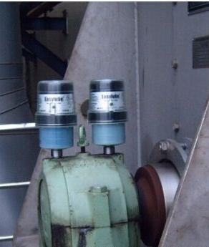
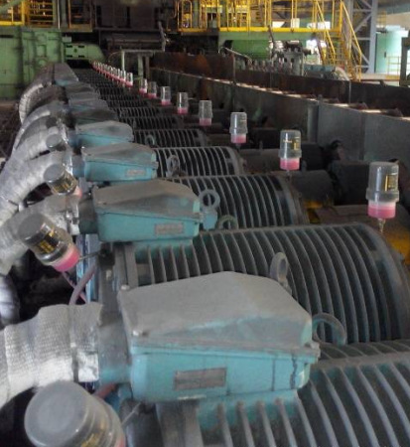
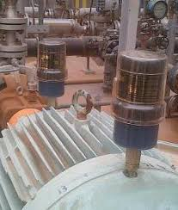
Applications
BEARINGS,
SLIDING GUIDES,
CHAINS
OPEN GEARS
MOST ADVANCED
FLEXIBLE
SAFE
CLEAN
LONG-LASTING
DYNAMIC
RELIABLE
HEAVY-DUTY
RUGGED
POWERFUL
RESISTANT

Slide 22
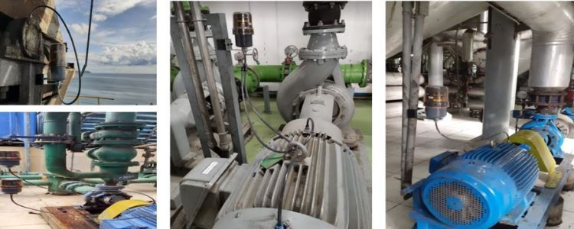
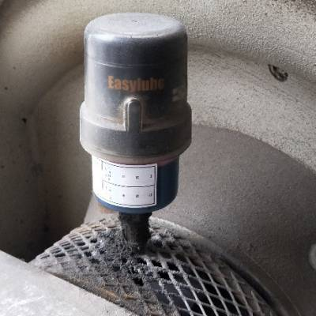
CRUSHER
BLOWER
SCREEN
FANS
PUMPS
Machine Components
HAMMER MILL
COMPRESSORS
CONVEYORS
E-MOTORS,

Slide 23
Solutions for Every Industry
AUTOMOTIVE
POWER GENERATION
STEEL / IRON
MINING
WATERWORKS / SEWAGE
CHEMICAL
SHIPPING / MARINE / TRANSPORTATION
MANUFACTURING
CEMENT / TILE
BEVERAGE / BREWERY

Slide 24
Quality Assurance
TWO-YEAR WARRANTY
During warranty period,
any defective unit will be replaced by authorized distributors.
(Terms & Conditions Apply)

Slide 25
Research & Feedback
Proactive maintenance has now received worldwide attention as the single most important means of achieving savings unsurpassed by conventional maintenance techniques. James C. Fitch. P.E.
Much of the maintenance in most plants is performed in accordance to guesswork based on an owner’s manual as opposed to the machine’s true condition and need. A Forbes Magazine study
It is almost certain that equipment is either being over‐lubricated or under lubricated, and with most sites, management doesn’t know which. Lubrication Engineer, UNOCAL Corp.
6‐7% of the gross national product (240 billion) is required just to repair the damage caused by mechanical wear. Wear occurs as a result of poor lubrication practices. Massachusetts Institute of Technology

Slide 26
Research & Feedback
A lubrication/contamination control program was implemented plant wide that reduced the cumulative frequency of all tribological failures (from wear & contamination) by 90%. Nippon Steel
A study was done that concluded lubrication system cleanliness extended time between repairs by 20‐50 times depending on level of cleanliness. The British Hydromechanics Research Assn.
International Paper reported a 90% reduction in bearing failures in just six months after they implemented a lubrication/ contamination control program in their Pine Bluff Paper Mill. International Paper Company
It is generally accepted in the lubrication community that 60% of all mechanical failures are due to inadequate or improper lubrication practices. Kenneth Bannister, Lubrication for industry

Slide 27
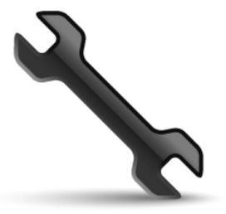
Increase your bottom line!
Fewer Breakdowns, Less Maintenance
1. steady, systematic, effective lubrication
2. long-term saving through effective maintenance management
4. Excellent technical support and service
5. Reduced production downtimes
6. REMOVE UNCERTAINTY with hi-tech condition monitoring
3. enhanced job safety by eliminating difficult manual lubrication

