Slide 1
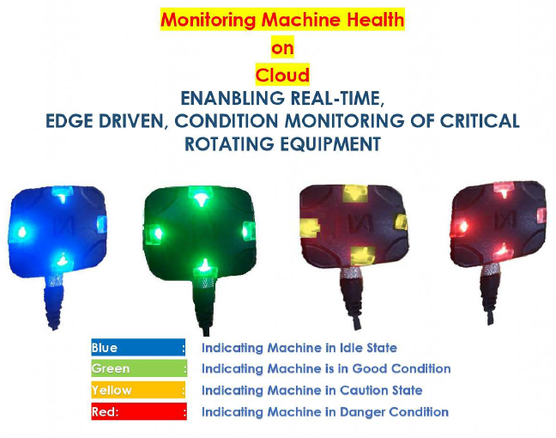
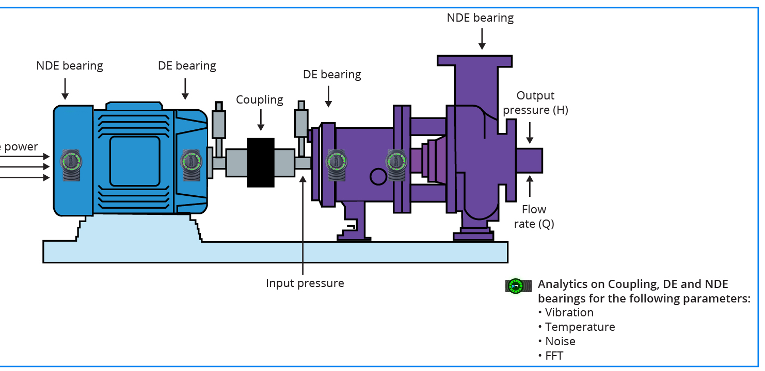
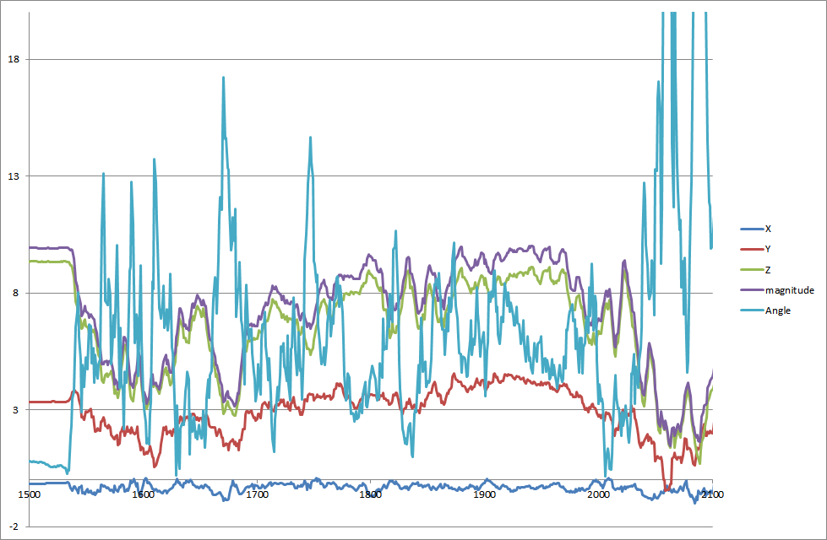
This Photo by Unknown Author is licensed under CC BY-SA

Slide 2
PROPOSITION VALUE
Patented Edge technology
Plug and Play – Installation
Real-time Data with Edge computing
Insights for decision-making
Equipment Health Monitoring
Reporting
Increases Safety

Slide 3
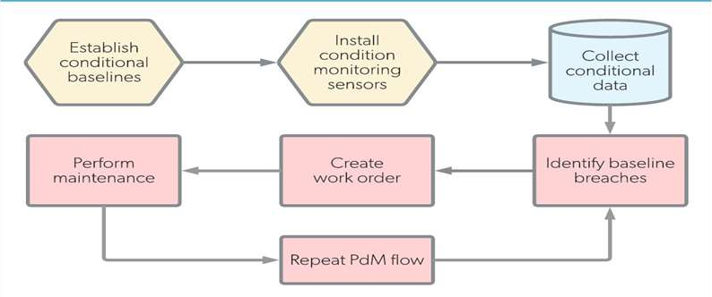
TREND FOR CONDITION MONITORING/PREDICTIVE MAINTENANCE

Slide 4
What does IDE sensor do ?
Detects anomaly that can cause failure
Identifies the source of problem
Predicts future development of degradation
Promotes Diagnostic analysis
Reduces unplanned downtime
Increase MTBF
Leads to improved safety
Increase equipment reliability
Increase revenue

Slide 5
WHY INDUSTRIAL DATA ENABLER (IDE)”VEDGE” 1.6
Features | Advantages | Benefits to customer / Client
Made In India Product | Every component is made in India | Economical
Plug and Play installation | Installation within a minute | No need to compromise on Operational schedule of the plant.
Visual LED Indicator on the machine for edge (Computing) | Various colours of LED indicate the equipment status at real-time. | No training required for the shop-floor team. A change in colour of the LEDs is an indication of discrepancy
Threshold setting configurable for generating alerts | Equipment Health Monitoring | Threshold can be set as per ISO standards and or shop floor requirements
Complete / End-to-end Solution | A system with hardware, software, firmware, power-cable, and mounting options | No charges for cloud, dashboard, additional hardware.
CE/FCC, EMI,EMC, IP68 Certified device | International Certifications ensures conformance to quality | Can be deployed in hazardous areas. and is not affected by local radiations.
Mobile based Android Application | Remote monitoring ready | Remote monitoring of equipment at any instance of time, from any geographical helps real time status awareness
Monitors triaxial vibrations, plus temperature and acoustics at sensor location | Captures vibrations in axial, horizontal and vertical axes, surface temperature and noise levels. | Insights for decision making. Based on multiple inputs. Potentially predicts 80% of the faults at 20% costs

Slide 6
Features\ Instruments> | Infinite uptime IDE Spec 1.2 version | Infinite uptime IDE Spec 1.5 version | Infinite uptime IDE Spec 1.6 version
Real time and trend monitoring | YES | YES | YES
DAQ to PC | Wireless/ Online | Wireless/ Online | Wireless/ Online/ wired
sensor to DAQ connection | Wireless | Wireless | Wireless
Online spectrum analysis 24*7 | YES | YES | YES
Local RS485 - Modbus RTU communication | No | No | YES
DCS connectivity option | No | No | YES
Offline recording of Vibration, temp and acoustic on mobile | No | No | YES
MEMS sensor | YES | YES | YES
Frequency range | 10 Hz -1.3kHz | 10 Hz -1.3kHz | 10 Hz -1.3kHz
Line of resolution | 1600 | 1600 | 3200
Alarm | YES | YES | YES
Power supply | 5V DC (0.5A) | External , 24 VDC | External , 24 VDC
WIFI Range | 25 m | 35 m | 35 m
Email alert | YES | YES | YES
communication | WIFI | WIFI | WIFI
Diagnostic facility | Yes, for simple fault | Yes, for simple fault | Yes, for simple fault
Acceleration & velocity FFT | YES | YES | YES
Temperature measurement | YES | YES | YES

Slide 7
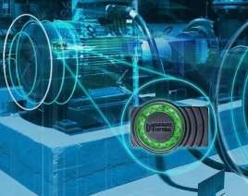
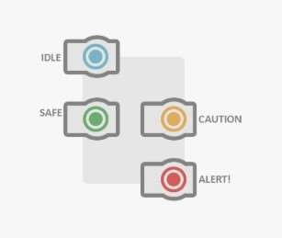
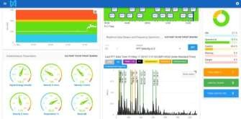
DIGITIZE ANY EQUIPMENT IN UNDER 1 Min
₁Installs on any machine within
₂ Immediate feedback through
Monitor remotely and wirelessly, to
3 mirror notifications and record data.
seconds through a magnetic connection.
visual fault-detecting indicators.
Multiple communication options, no additional infrastructure needed (WIFI, API, RS485,Via android)

Slide 8
ADMINISTRATION
Create an Organization
Create a plant in the same organization
Create an Administrator /Non-Administrator user for same organization
Assign Plants access rights to the user

Slide 9
CONFIGURATION
Create a machine group
Create a machine
Create a monitoring location
Register the Device
Create a Network

Slide 10
MONITORING
Monitor the machine states through dashboard
Trend 2. Gauges 3. History of machine 4. FFT/timewave form
5. Reporting 6. Maintenance index

Slide 11
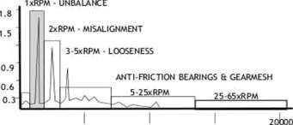
FAULTS THAT CAN BE DIAGNOSED (FFT BASED ANALYSIS)
Standard defects displayed
Looseness
Unbalance/Rub
Misalignment
Bearing Problems
Predefined Spectrum Analysis is Bands
Note – Analysis can also identify follow defects:-
Cavitation
Gear defect
Hydraulic issue
Bent shaft
Eccentricity
Pully defect
Resonance
Structural issue
10000
ROOT CAUSE ANALYTICS IN THE FREQUENCY DOMAIN

Slide 12
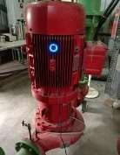
CASESTUDY: MOTOR (CHILLER PLANT)
Background
A Plastic Fabric Manufacture for agriculture goods has a motor which drives Chiller Circulating Pump in the plant.
Need
Real time Monitoring of the motor located in the basement of the plant was essential to ensure the Pump operation is smooth and subsequently achieve the production target.
Challenge
Sudden Failure of motor causing shut down of chiller leading to production losses.
Solution
IU has installed IDE “vEdge” on the motor connected to the Pump so that the equipment data can be seen on a real-time basis
Results
After a fortnight, the IDE “vEdge” noticed high vibrations on the motor, resulting alerts.
The trend generated, indicated that the rise in the vibrations was due to the loosening of the nuts and bolts, causing foundation issues in the motor.
Value Driven
Avoided production loss of approximately USD 26 Thousand per day in the Plant.
Saving USD 27 Hundred which was the estimated cost of the customized Circulating Chiller Pump.
Preventing breakdown in Lamination Plant.
Ensuring consistent operation of the Production Plant.

Slide 13
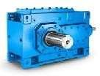
CASESTUDY: GEARBOX (PAPER INDUSTRY)
Background
A global leading Indian paper manufacturing company has a calendar machine run by a motor with a shaft mounted gearbox connected to the roller.
Need
To monitor & give insights on Unplanned downtime of gearbox which affected the Paper quality and the production goals
Challenge
In spite of scheduled preventive maintenance, the root cause of the frequent failure of gearbox was unknown.
Solution
IDE “vEdge” was installed at the bearing location supporting the output shaft of the gearbox to capture tri-axial vibrations, temperature, and acoustics in real-time
Results
After a 48 hours of deployment, the IDE “vEdge” noticed a steady rise in vibrations levels.
Real-time data through Fast Fourier Transform (FFT) indicated significant coupling misalignment.
The spectrum displayed high 1X peak as a result of angular misalignment attributed to coupling wear.
The misalignment severely loaded the gearbox input shaft.
Value Driven
The root cause of gearbox failure was investigated through insights that were given.
Avoided calendar roll shaft breakage saving production downtime of USD 60 Thousand.

Slide 14
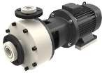
CASESTUDY: PUMP (FMCG INDUSTRY)
Background
An Indian FMCG company had a multiple assembly lines with a diverse set of machines connected to it. A single machine breakdown affected the whole production process, reducing the productivity.
Need
The company needed a solution to monitor health of its scrubber pump which always faced Unplanned Downtime.
Challenge
Servicing of the pump impeller, pump casing, bearing, shaft, and mechanical seals did not resolve the pump failure.
Solution
IDEs “vEdge” was deployed on the Drive and Non Drive end of the scrubber-pump motor to collect the triaxial vibrations, temperature data on a real-time basis.
Results
After a fortnight, the IDE “vEdge” noticed a slight rise in vibrations and temperature levels. The trend
Insights pointed to the instability of the pump in its radial and axial axis.
The root cause was the loosening of the nuts and bolts causing foundation issues in the motor. The origin of pump failure provided a guideline to take a corrective action to stabilize the pump.
Value Driven
Expected potential mechanical breakdown of 8 to 15 hours was avoided.
Saved the raw materials from degradation, saving 15% of raw material cost.

Slide 15
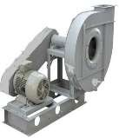
CASESTUDY: BLOWER (PAINT SHOP IN AUTOMOTIVE INDUSTRY)
Background
One of the largest motorcycle company in India wanted to streamlined the operation of the Paint Shop to maintain continuity in the main product assembly line.
Need
To monitor the blower-motor driving the assembly line and to safeguard the safety of workforce & to prevent downtime.
Challenge
Monitoring the operation of the blower-motor situated at inaccessible location was necessary, as its poor performance subsequently resulted in hazardous working environment in the plant.
Solution
IDE “vEdge” was installed on the blower-motor, so that the real-time triaxial vibrations, temperature data can be monitored
Results
After a week, the IDE “vEdge” noticed rise in temperature blower-motor. The trend generated invoked a Close-inspection and revealed that the motor windings were inadequately lubricated
Value Driven
Saved the Production downtime of one shift.
Ensured the extended life of the motor
Maintained continuity of the assembly line operations.
Saved USD 40 Thousand per hour for the Assembly line, and asset repairs and rebuild of USD 6 Thousand

Slide 16
FEATURE COMPARISON
Notes:
IDE IS A FULL FEATURE, ADVANCED TECHNOLOGY LOW COST MONITORING SYSTEM

Slide 17
OUR CURRENT PARTNERS AND THEIR INDSUTRIES/EQUIPMENT
FMCG, Automotive, Paper, Ceramic, Steel, Motor Pump, Chiller, Blower Fan

Slide 18
For more information please contact us:

